Slide 1
Thread in .Net

Slide 2
Process and Thread
An application consists of one or more processes. A process, in the simplest terms, is an executing program.
One or more threads run in the context of the process. A thread is the basic unit to which the operating system allocates processor time.
A thread can execute any part of the process code, including parts currently being executed by another thread.

Slide 3
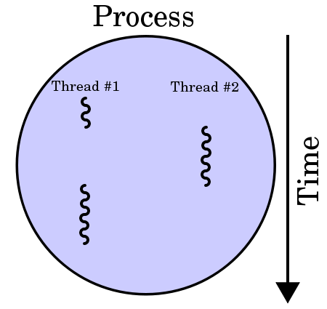
Thread in Single-core CPU
Systems with a single processor generally implement multithreading by time slicing: the central processing unit (CPU) switches between different software threads. This context switching generally happens very often and rapidly enough that users perceive the threads or tasks as running in parallel

Slide 4
Thread in Multi-core CPU
On a multiprocessor or multi-core system, multiple threads can execute in parallel, with every processor or core executing a separate thread simultaneously; on a processor or core with hardware threads, separate software threads can also be executed concurrently by separate hardware threads.

Slide 5
Thread class in .Net
Namespace: System.Threading
Assembly: mscorlib (in mscorlib.dll)
Ref: https://msdn.microsoft.com/en-us/library/system.threading.thread(v=vs.110).aspx

Slide 6
Basic properties
IsAlive | Gets a value indicating the execution status of the current thread.
IsBackground | Gets or sets a value indicating whether or not a thread is a background thread.
IsThreadPoolThread | Gets a value indicating whether or not a thread belongs to the managed thread pool.
ManagedThreadId | Gets a unique identifier for the current managed thread.
Name | Gets or sets the name of the thread.
Priority | Gets or sets a value indicating the scheduling priority of a thread.
ThreadState | Gets a value containing the states of the current thread.

Slide 7
Basic methods
Abort() | Raises a ThreadAbortException in the thread on which it is invoked, to begin the process of terminating the thread. Calling this method usually terminates the thread.
Finalize() | Ensures that resources are freed and other cleanup operations are performed when the garbage collector reclaims the Thread object.
Join() | Blocks the calling thread until the thread represented by this instance terminates
Start() | Causes the operating system to change the state of the current instance to ThreadState.Running.

Slide 8
Example code
using System;
using System.Diagnostics;
using System.Threading;
public class Example
{
public static void Main()
{
var th = new Thread(ExecuteInForeground);
th.Start();
Thread.Sleep(1000);
Console.WriteLine("Main thread ({0}) exiting...",
Thread.CurrentThread.ManagedThreadId);
}
private static void ExecuteInForeground()
{
DateTime start = DateTime.Now;
var sw = Stopwatch.StartNew();
Console.WriteLine("Thread {0}: {1}, Priority {2}",
Thread.CurrentThread.ManagedThreadId,
Thread.CurrentThread.ThreadState,
Thread.CurrentThread.Priority);
do {
Console.WriteLine("Thread {0}: Elapsed {1:N2} seconds",
Thread.CurrentThread.ManagedThreadId,
sw.ElapsedMilliseconds / 1000.0);
Thread.Sleep(500);
} while (sw.ElapsedMilliseconds <= 5000);
sw.Stop();
}
}
// The example displays output like the following:
// Thread 3: Running, Priority Normal
// Thread 3: Elapsed 0.00 seconds
// Thread 3: Elapsed 0.51 seconds
// Main thread (1) exiting...
// Thread 3: Elapsed 1.02 seconds
// Thread 3: Elapsed 1.53 seconds
// Thread 3: Elapsed 2.05 seconds
// Thread 3: Elapsed 2.55 seconds
// Thread 3: Elapsed 3.07 seconds
// Thread 3: Elapsed 3.57 seconds
// Thread 3: Elapsed 4.07 seconds
// Thread 3: Elapsed 4.58 seconds

Slide 9
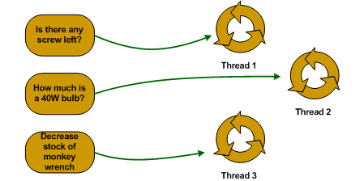
Multi thread
Thread Pool

Slide 10
Example code using Thread pool
using System;
using System.Threading;
namespace ThreadPoolTest
{
class MainApp
{
static void Main()
{
WaitCallback callBack;
callBack = new WaitCallback(PooledFunc);
ThreadPool.QueueUserWorkItem(callBack,
"Is there any screw left?");
ThreadPool.QueueUserWorkItem(callBack,
"How much is a 40W bulb?");
ThreadPool.QueueUserWorkItem(callBack,
"Decrease stock of monkey wrench");
Console.ReadLine();
}
static void PooledFunc(object state)
{
Console.WriteLine("Processing request '{0}'", (string)state);
// Simulation of processing time
Thread.Sleep(2000);
Console.WriteLine("Request processed");
}
}
}
Processing request 'Is there any screw left?'
Processing request 'How much is a 40W bulb?'
Processing request 'Decrease stock of monkey wrench'
Request processed
Request processed
Request processed

Slide 11
When Not to Use Thread Pool Threads
You require a foreground thread.
You require a thread to have a particular priority.
You have tasks that cause the thread to block for long periods of time. The thread pool has a maximum number of threads, so a large number of blocked thread pool threads might prevent tasks from starting.
You need to place threads into a single-threaded apartment. All Threadpool threads are in the multithreaded apartment.
You need to have a stable identity associated with the thread, or to dedicate a thread to a task.

Slide 12
Lock

Slide 13
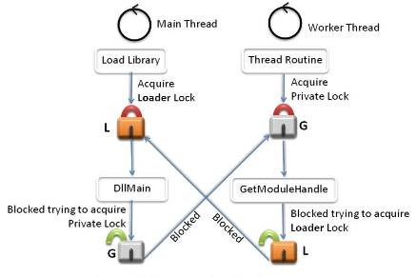
Deadlock

Slide 14
Threading mode
(STA) Single Threaded Apartment Model Threads
(MTA) Multi Threaded Apartment Model Threads
Ref: https://blogs.msdn.microsoft.com/larryosterman/2004/04/28/what-are-these-threading-models-and-why-do-i-care/

Slide 15
(STA) Single Threaded Apartment Model Threads
When a thread indicates that it’s going to be in single threaded apartment, then the thread indicates to COM that it will host single threaded COM objects. Part of the contract of being an STA is that the STA thread cannot block without running a windows message pump (at a minimum, if they block they must call MsgWaitForSingleObject – internally, COM uses windows messages to do inter-thread marshalling).
The reason for this requirement is that COM guarantees that objects will be executed on the thread in which they were created regardless of the thread in which they’re called (thus the objects don’t have to worry about multi-threading issues, since they can only ever be called from a single thread). Eric mentions “rental threaded objects”, but I’m not aware of any explicit support in COM for this.

Slide 16
(MTA) Multi Threaded Apartment Model Threads
Threads in the multi threaded apartment don’t have any restrictions – they can block using whatever mechanism they want. If COM needs to execute a method on an object and no thread is blocked, then COM will simply spin up a new thread to execute the code (this is particularly important for out-of-proc server objects – COM will simply create new RPC threads to service the object as more clients call into the server).

Slide 17
Method Join()
Blocks the calling thread until the thread represented by this instance terminates, while continuing to perform standard COM and SendMessage pumping.
using System;
using System.Threading;
public class Example
{
static Thread thread1, thread2;
public static void Main()
{
thread1 = new Thread(ThreadProc);
thread1.Name = "Thread1";
thread1.Start();
thread2 = new Thread(ThreadProc);
thread2.Name = "Thread2";
thread2.Start();
}
private static void ThreadProc()
{
Console.WriteLine("\nCurrent thread: {0}", Thread.CurrentThread.Name);
if (Thread.CurrentThread.Name == "Thread1" &&
thread2.ThreadState != ThreadState.Unstarted)
thread2.Join();
Thread.Sleep(4000);
Console.WriteLine("\nCurrent thread: {0}", Thread.CurrentThread.Name);
Console.WriteLine("Thread1: {0}", thread1.ThreadState);
Console.WriteLine("Thread2: {0}\n", thread2.ThreadState);
}
}
// The example displays output like the following:
// Current thread: Thread1
//
// Current thread: Thread2
//
// Current thread: Thread2
// Thread1: WaitSleepJoin
// Thread2: Running
//
//
// Current thread: Thread1
// Thread1: Running
// Thread2: Stopped

Slide 18
ManualResetEvent
ManualResetEvent allows threads to communicate with each other by signaling. Typically, this communication concerns a task which one thread must complete before other threads can proceed.
When a thread begins an activity that must complete before other threads proceed, it calls Reset to put ManualResetEvent in the non-signaled state. This thread can be thought of as controlling the ManualResetEvent. Threads that call WaitOne on the ManualResetEvent will block, awaiting the signal. When the controlling thread completes the activity, it calls Set to signal that the waiting threads can proceed. All waiting threads are released.
Once it has been signaled, ManualResetEvent remains signaled until it is manually reset. That is, calls to WaitOne return immediately.
You can control the initial state of a ManualResetEvent by passing a Boolean value to the constructor, true if the initial state is signaled and false otherwise.
ManualResetEvent can also be used with the staticWaitAll and WaitAny methods.
Ref: https://msdn.microsoft.com/en-us/library/system.threading.manualresetevent(v=vs.110).aspx

Slide 19
Problem when using thread
Can’t use thread to access Window Form controls, because Windows Forms controls is not inherently thread safe. Use to InvokeRequired to resolve
Can’t use thread to write file

